Slide 1
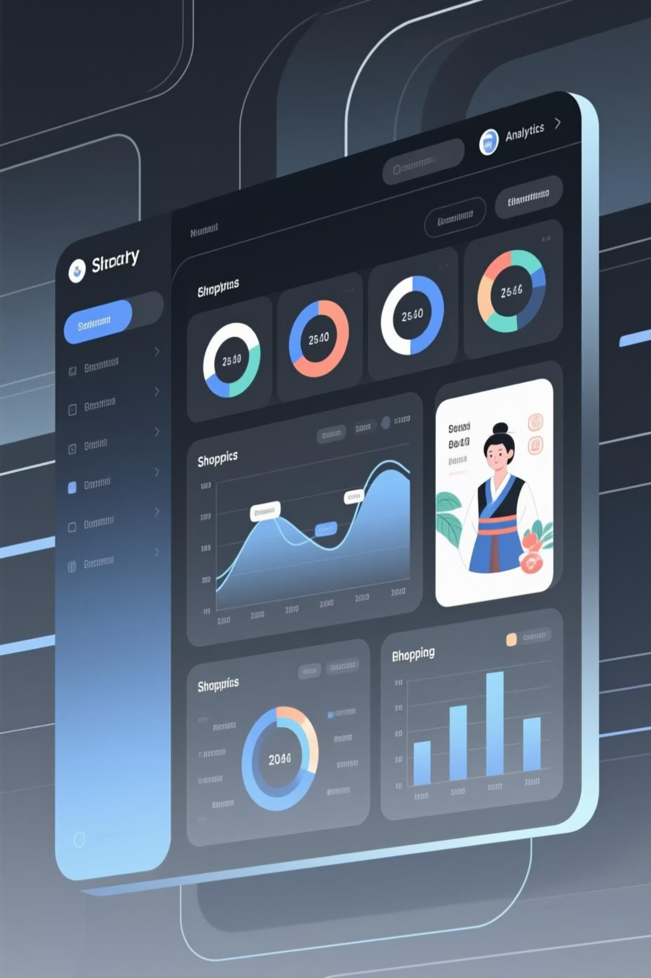
Customer Shopping Behavior Analysis
Uncovering insights from 3,900 purchases to guide strategic business decisions

Slide 2

DATASET OVERVIEW
The Foundation
3,900
18
50
Total Purchases
Data Columns
Locations
Transactions analyzed across all categories
Comprehensive customer and purchase attributes
Geographic diversity in customer base
25
Products
Items tracked across four major categories

Slide 3

PYTHON ANALYSIS
Data Preparation & Cleaning
01
02
03
Data Loading
Missing Data
Standardization
Imported dataset using pandas, explored structure with df.info() and summary statistics
Imputed 37 missing Review Rating values using median by product category
Renamed columns to snake_case, verified data consistency
04
05
Feature Engineering
Database Integration
Created age_group and purchase_frequency_days columns
Connected to PostgreSQL and loaded cleaned data for SQL analysis

Slide 4

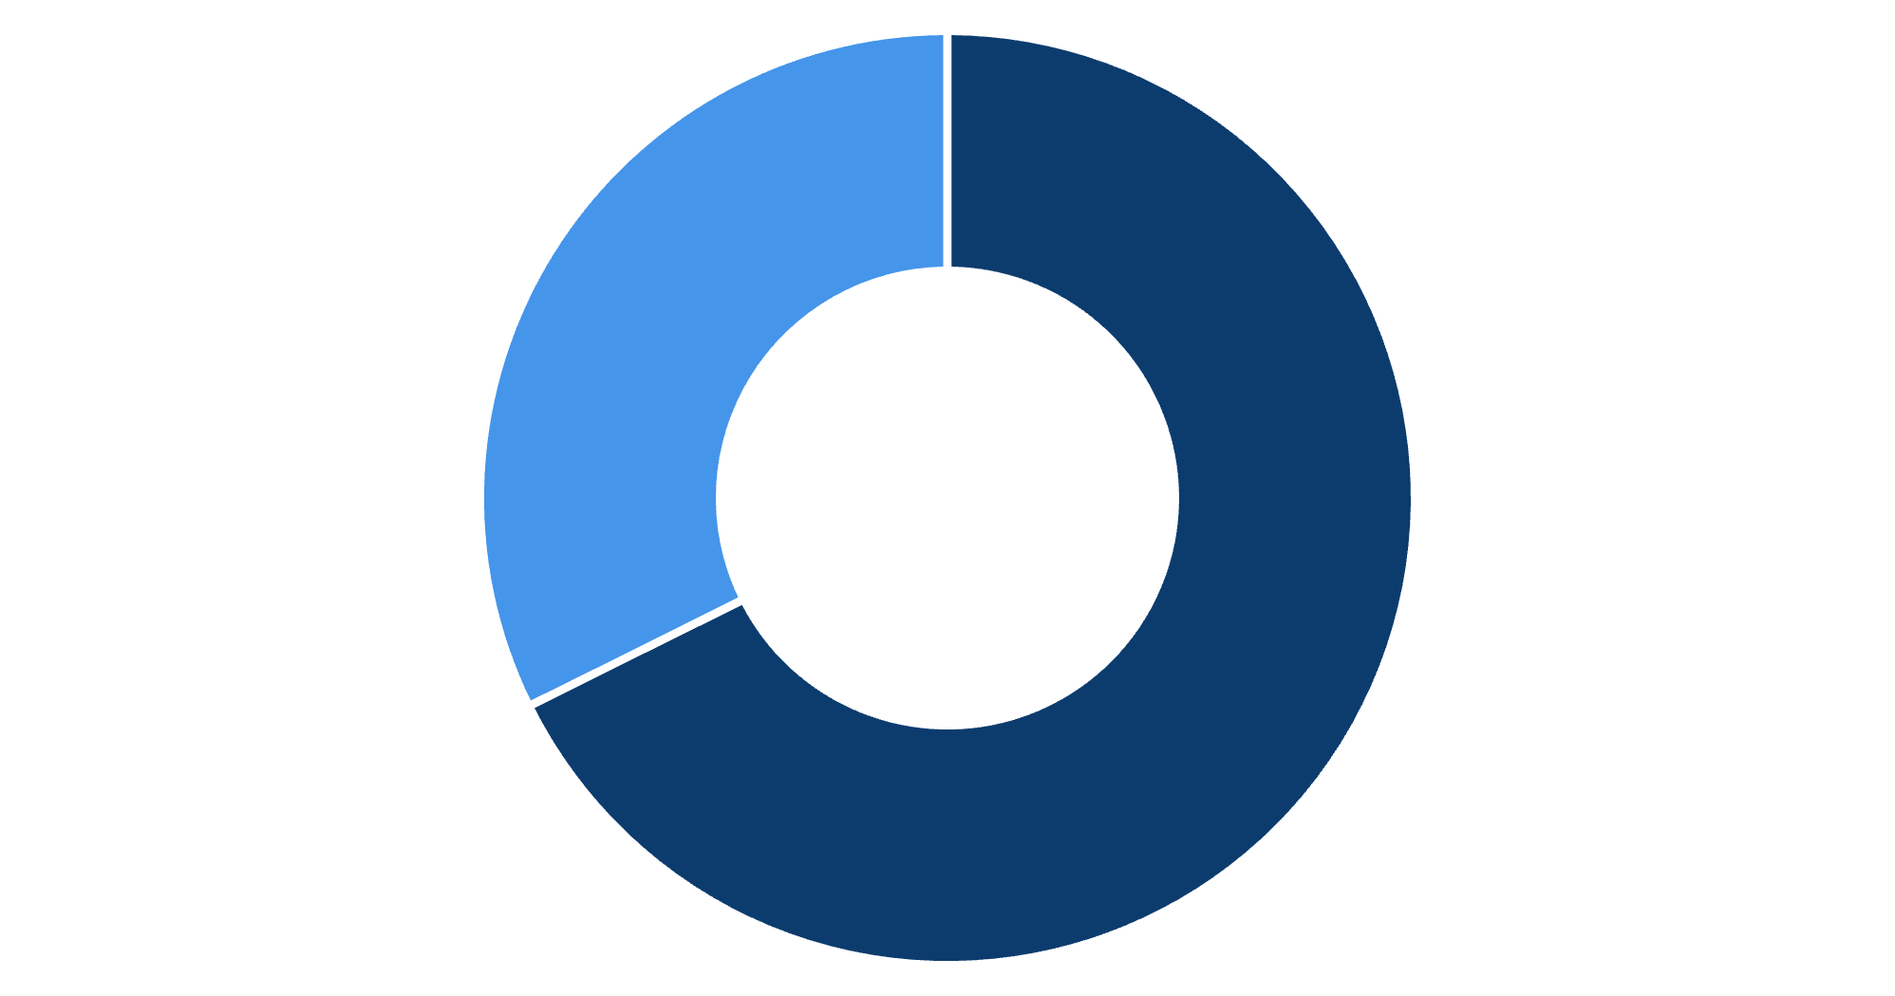
SQL INSIGHTS
Revenue by Gender
Key Finding
Male customers generate 68% of total revenue, more than double female customer spending.
This suggests opportunities for targeted marketing campaigns to increase female customer engagement.
Male
Female

Slide 5

Product Performance Insights
1
2
3
Gloves
Sandals
Boots
Highest rated: 3.86 average
Strong performer: 3.84 average
Customer favorite: 3.82 average
4
5
Hat
Skirt
Solid rating: 3.80 average
Top 5 product: 3.78 average

Slide 6

Discount Strategy Analysis
High-Spending Discount Users
Discount-Dependent Products
839 customers used discounts but still spent above average purchase amount.
Hat: 50% discount rate
Sneakers: 49.66%
These savvy shoppers demonstrate that discounts don't always mean lower revenue per transaction.
Coat: 49.07%
Sweater: 48.17%
Pants: 47.37%

Slide 7






CUSTOMER SEGMENTS
Loyalty Distribution
New
83 customers
Returning
701 customers
Loyal
3,116 customers
80% of customers fall into the Loyal segment, indicating strong retention. Focus on converting New and Returning customers into this valuable group.

Slide 8


Subscription vs. Non-Subscription
Subscribers
1,053 customers
Average spend: $59.49
Total revenue: $62,645
Non-Subscribers
2,847 customers
Average spend: $59.87
Total revenue: $170,436
Repeat buyers (>5 purchases): 958 subscribers vs. 2,518 non-subscribers. Opportunity to convert loyal non-subscribers into subscription members.

Slide 9
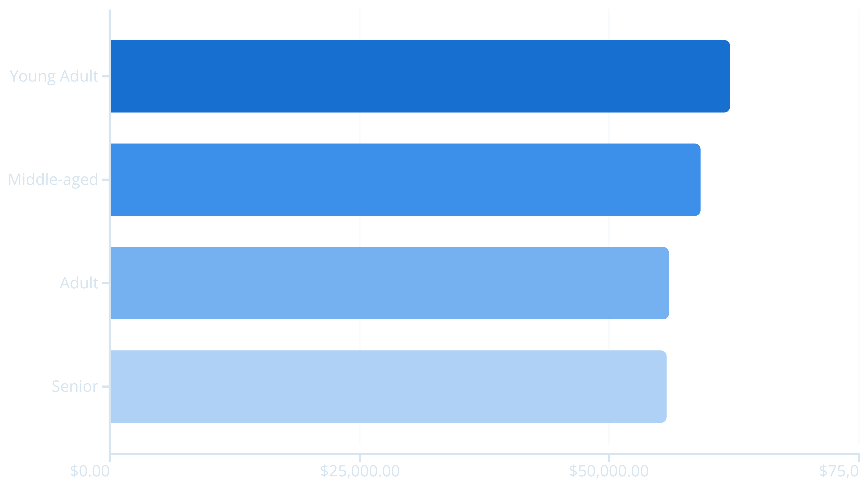
Revenue by Age Group
Young Adults lead revenue generation, followed closely by Middle-aged customers. Relatively balanced distribution suggests broad market appeal.

Slide 10








ACTION PLAN
Strategic Recommendations
Boost Subscriptions
Loyalty Programs
Review Discounts
Promote exclusive benefits to convert loyal non-subscribers
Reward repeat buyers to strengthen retention
Balance sales boosts with margin control
Product Positioning
Targeted Marketing
Highlight top-rated items in campaigns
Focus on high-revenue segments and express shipping users

